Slide 1
SITE Reliability Engineering Training phase 1 – Dec 14to 23rd
Topics
S/W. Development Models
[ Agile, DevOps, DevSecOps]
SRE
Virtual Box, Vagrant, NGINX [ Linux]
Container - Dockers

Slide 2
Content [Module 1] [Assignment 1] Dec 14th – 16th
Software Development Evolution
Waterfall
Agile Development
DevOps [ CI CD Pipeline]
DevSecOps [Practice/Culture]
Site Reliability Engineering [Practice/Culture]

Slide 3
Day 2 - Software Development Models
Introduction to DevSecOps
Break – 11 AM to 11.15 AM
Demonstration – CICD Pipeline [AWS/Azure]
Intro to SRE Concepts
Assessment Time

Slide 4
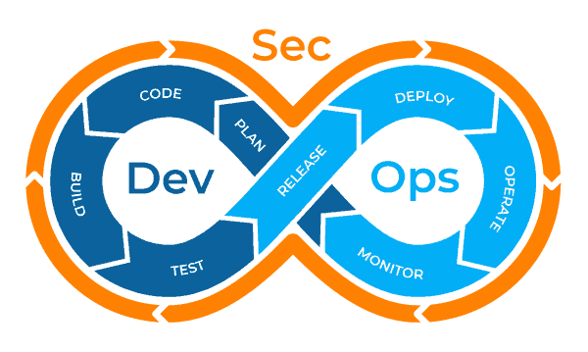
Importance Of DevSecOps: Adding Security To DevOps
In the race, if delivering faster, the security of the data is often overlooked. With the implementation of DevOps, quality is improved, but developers fail to inspect the security concepts of the system.
DevOps transformed the organization's processes to deliver more applications with less delivery time. But the risk of security beaches made more than 43% company to include security practices within the DevOps processes.
DevSecOps bridges the distance between the development engineers and the security team. The unification of development, operations and security promises to give solutions to complex software development processes using an agile framework.
DevSecOps is imperative for advancing the older security models within the DevOps continuous delivery pipeline. It ensures that the codes remain safe and are delivered in a fast and secure manner.
Notes:
The process needs to be followed throughout all the phases of delivery. Thus, DevSecOps together with DevOps emphasizes and streamlines the two main but opposing goals: “Speedy delivery” and “Code security”.
During the cycle, security testing is done parallelly without breaking or slowing down the delivery cycles. In the meantime, if any critical issue is raised, it is rectified at the same time ensuring that no threat occurs at the later stages or there is no room left for compromise at any stage.
So, what are the benefits of DevSecOps approach? Let’s have a look.

Slide 5
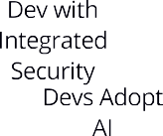




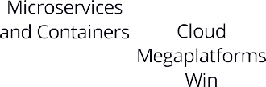





The Urgency of Dev with Integrated Security
●
Development without integrated security and compliance will fail;
– progressive orgs have prioritized security due to uptime and compliance concerns accelerating the need for agility and a curated OSS-dev portfolio.
–
●
Security-led development will be a priority for 90% of orgs by 2020.

Slide 6
What is DevSecOps?
IS | IS NOT
A Mindset and Holistic Approach | A One-Size-Fits-All Approach
A Collection of Processes & Tools | A Single Tool or Method
A Means of Security & Compliance Integrated to Software | Just a means of adding Security into Continuous Delivery
A Community Driven Effort | Invented by Vendors
A Strategy Driven by Learning and Experiments | A Strategy Driven by Perfection and Compliance

Slide 7
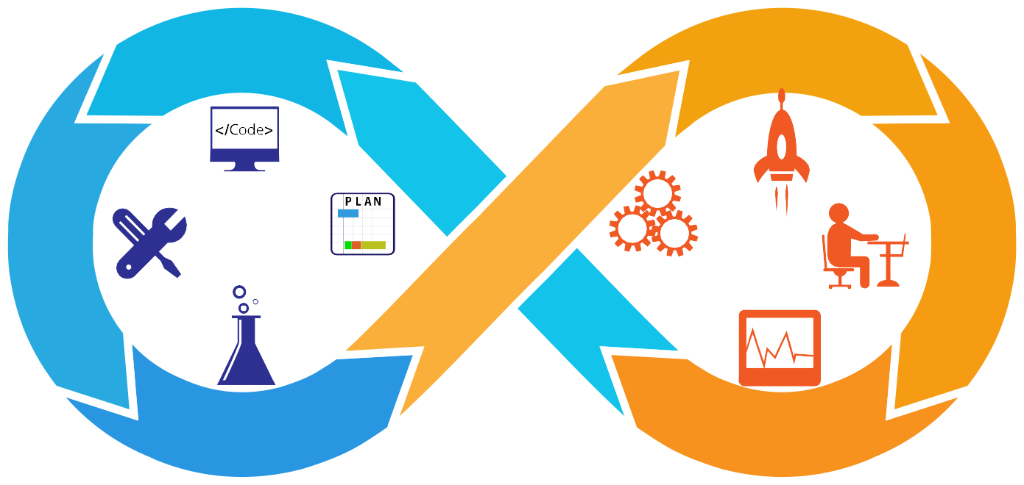
DevSecOps: Integrate Security Into DevOps
Static Analysis
Code
Audit
Code Review
Threat Model
Policies
Plan
Release
Log
Deploy
Threat Intelligence
Monitor
Operate
Detect
Response Recover
Build
Penetration Testing
Compliance Validation
Test
Monitor

Slide 8

The Main Course
Vulnerability (VA) Scans and Assessments
Threat Modeling
Secure Code Reviews (Static Code Analysis)
Penetration Tests (PenTests) This applies to both Custom Apps and COTS

Slide 9

The Gravy
Educating Developers on Secure Coding
Practices with workshops, talks, lessons
Secure Coding Standards Responsible/Coordinated Disclosure
Secure code library and other reference materials, creating custom tools

Slide 10

The Dessert
Bug Bounty Programs
Capture The Flag (CTF) contests
Red Team Exercises

Slide 11


Best Practices
Successful security programs involve three intersecting parts: people, processes, and technologies.
People
People are the starting point of the DevSecOps implementation. Through ensuring proper training and restructuring of teams security will become a frame of mind rather than a hindrance.
Processes
DevSecOps aims to align and implement processes common to an enterprise to facilitate cooperation and achieve more secure development processes as a whole.
Technology
Technologies enable people to execute DevSecOps processes, which aim to reduce the enterprise attack surface and enable effective management of the technical security debt.

Slide 12
People: Security Champions
Ensure that security is not a blocker on active development or reviews
Be empowered to make decisions
Work with AppSec team on mitigations strategies
Help with QA and Testing
Write Tests (from Unit Tests to Integration tests)
Help with development of CI (Continuous Integration) environments
Keep track of and stay up to date on modern security attacks and defenses
Introduce body of knowledge from organizations such as OWASP (Top 10, Application Security Verification Standard, Testing Guide etc.)

Slide 13
Secure Processes
Version control, metadata, and orchestration Integration of processes
Security tooling in CI/CD Compliance
Security Architecture Incident Management
Red Teams and Bug Bounties Threat Intelligence

Slide 14
Secure Technologies
Automation and Configuration Management Secure coding practices/Security as Code Host Hardening
CI/CD for Patching
Application-level Auditing and Scanning Automated Vulnerability Management Scanning Automated Compliance Scan
Managing Secrets

Slide 15
















How Hard Could It Be?
DevOps Code - Creating Value & Availability
Source Code
CI Server
Test & Scan
Artifacts
Deploy
Monitoring
DevSecOps Code - Creating Trust & Confidence

Slide 16

Managing Secrets: HSM
Hardware Security Module
Cryptographic Computing Hardware Module Protected Key Store
Well-Defined Interface Protocol Hard to Compromise
●
●
●
●

Slide 17
Conclusion
DevSecOps addresses the need for pro-active, customer- focused security rather than reacts to data breaches or other cyberattacks.
The benefits are cost reduction, speed of delivery, speed of recovery, compliance at scale, and threat hunting.
DevSecOps provides the ability to detect and fix security issues earlier in the development process thus reducing greatly the cost associated with identifying and fixing them.
Shifting security to the left through the use of people, processes and technology will help to achieve this goal.

Slide 18
Ensuring a Durable Focus on
Engineering
Pursuing Maximum Change Velocity Without Violating a Service’s SLO
Monitoring
Emergency Response
Change Management
Demand Forecasting and Capacity Planning
Provisioning
Efficiency and Performance
What is SRE?
"an SRE team is responsible for the availability, latency, performance, efficiency, change management, monitoring, emergency response, and capacity planning of their service(s)."

Slide 19
DevOps V/S SRE ?
SRE
Share Ownership with Developers
SLO's Reduce cost of failures(canary)
Automation focused/reduce toil
Measure Reliability
DevOps +DevSecOps
Reduce Organizational Silos
Accept failure as normal
Implement Gradual change
Leverage tooling &
Automation Measure everything

Slide 20


Availability
"If you haven't tried it, assume it's broken"
Time Based
Aggregate Based
Too binary for distributed systems that can enter partial downtime or degraded states
Much broader and able to capture user facing experience more effectively
PROPRIETARY AND CONFIDENTIAL
20

Slide 21
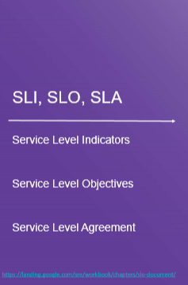
90% ( averaged over 1 minute ) of http requests to the backend should complete in less than 10ms
"99% of pipeline runs cover 100% of the
data."
Database state should be 100% recovered in
no more than 1 day.
21

Slide 22
Error Budgets
"Ways in which things go wrong are special cases of the ways in which things go right"
Error budgets enable teams to make objective decisions regarding prioritization of
features versus reliability.
Given an availability target the error budget defines the tolerable amount of service unavailability. i.e., 99.99% availability => 0.01% unavailability or 12.96 minutes per quarter
https://landing.google.com/sre/sre-book/chapters/availability-table/
https://landing.google.com/sre/workbook/chapters/error-budget-policy/
PROPRIETARY AND CONFIDENTIAL

Slide 23
Being Agile with SLOs
Transparency - the SLO and error budget policies along with all other relevant material should be made available to the team and stake holders
Inspection - the team should regularly review and analyze the effectiveness and relevancy of the policies
Adaptation - The team should be willing to adjust the policies so as to maximize the value delivered to customers.
PROPRIETARY AND CONFIDENTIAL

Slide 24

“Left Shift From Reactive To Proactive“
Reliability: Transforming From Reactive to proactive
Site Reliability Engineering
SRE is what happens when a software engineer is put to solve operations problems
It is a outcome of system to be able to withstand some certain types of failure and still remain functional from a user’s perspective.

Slide 25
Who should go for this role ?
A Developer who want to go ahead and apply his/her software engineering skills in operational tasks.
An Operations engineer who want to go ahead and learn software development , programming and scripting skills.
An Engineer who wants to go ahead in architecting of complete infrastructure.

Slide 26



Core Components of SRE
Availability
Performance
Monitoring
Incident Response
Runbooks / Preparation
8
8
6 %
3
8 8
8
0 0
5
5
4
% % % ₀
0 % |  |  |  | % | %
2 | 2 | 2 | 2 | 2 | 2 | 2
0 | 0 | 0 | 0 | 0 | 0 | 0
1 | 1 | 1 | 1 | 1 | 1 | 1
0 | 1 | 2 | 3 | 4 | 5 | 6

Slide 27
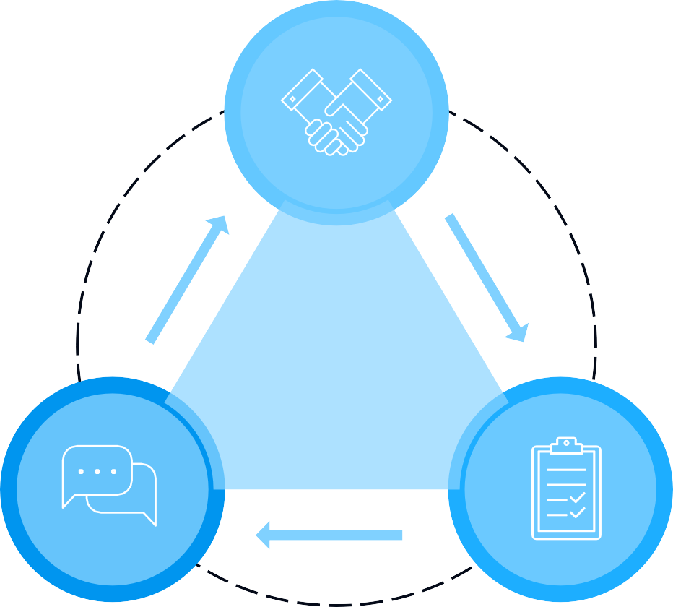
Defining Service levels
SLA
(Service level agreements)
An agreement between client
and service provider
Based on
SLI
(Service level Indicators)
Indicators/metrics which indicates the uptime of your website
SLO
(Service level Objectives)
These are the objectives decides on
the basis of Agreements

Slide 28

Focus on
Golden signals which SRE monitors and follows to make complete system and infrastructure reliable
Latency
Time taken to process a
request and result as a successful request
Traffic
If traffic is properly balanced
on the applications coming from globe
Errors
how capable to handle the
errors from under promised SLA
Saturation
High level utilization of a service. we should aware of a systems max and min limit.

Slide 29
SRE - Roles and Responsibilities
On call
Blameless RCA/Post-mortem
Effective Monitoring infrastructure
Senior SRE’s should involve junior SRE’s
Get better understanding on Product’s in and out and how to improve the performance
Automate everything and reduce toil
Create Runbooks for crisis

Slide 30
Impact of S RE
Site Reliability Engineering is synonymous with business availability
Your product’s quality will get mature
More time for developers to look at development and new features instead of solving production problems
Customer's faith will increase in your services.
You will have more intelligent team for your intelligent products

